Slide 1
GP-guided MPPI for Efficient Navigation in Complex Unknown Cluttered Environments
Ihab S. Mohamed, et al.
International Conference on Intelligent Robots and Systems (IROS), Detroit, Michigan, USA, 2023
Mayank Goud Polagoni
Model Predictive Path Integral (MPPI) Control
Gaussian Process (GP) Occupancy Mapping
GP-Guided MPPI Integration
2D Simulation Framework
Standard MPPI vs. GP-MPPI Comparison

Slide 2


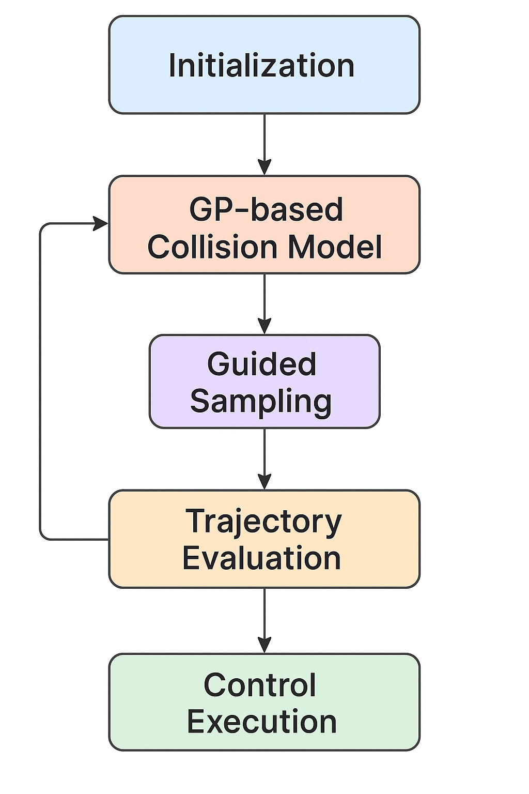
Introduction
Problem:
Navigating robots efficiently in complex, unknown, cluttered environments is challenging.
Traditional navigation methods typically require prior global maps, making them unsuitable for unknown or dynamic scenarios.
Existing sampling-based methods like MPPI waste computational resources sampling trajectories in unsafe regions, reducing real-time efficiency.
What I Solved:
Implemented GP-guided MPPI, a method that integrates Gaussian Process predictions into MPPI, without requiring any global map of the environment.
Gaussian Processes estimate collision probabilities based only on real-time local sensor data (e.g., LiDAR), guiding the sampling of MPPI trajectories towards safer, collision-free areas.
Result: Efficient, real-time, and safe navigation even in completely unknown and dynamically changing environments.

Slide 3
MPPI Overview
Model Predictive Path Integral (MPPI) is a sampling-based optimal control algorithm.
Sample many random control trajectories around the current state.
Simulate and evaluate each trajectory based on cost (goal, collisions, control effort).
Compute a weighted average of the best trajectories and apply the first control input.
Advantages of MPPI
Handles Complex Dynamics & Costs
No need for gradients — just sampling-based
Flexible and customizable cost function
High Parallelizable
Effective Trajectory Optimization
Drawbacks of MPPI
Computationally expensive (many rollouts)
Random sampling can waste effort in unsafe areas
Needs an accurate dynamics model
Requires Known Map — no global map awareness
Sensitive to parameter tuning

Slide 4
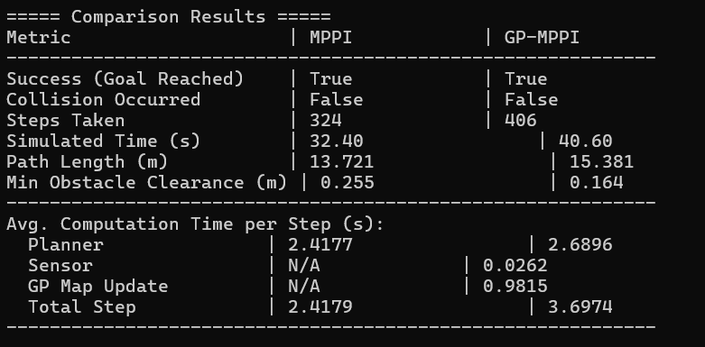
GP-MPPI Overview
An enhanced version of MPPI that integrates Gaussian Process (GP) modeling to guide trajectory sampling more intelligently.
How GP Mapping Works -
1. The robot uses real-time sensor data (e.g., LiDAR) to label observations:
0 → Free space (no collision)
1 → Occupied space (collision)
2. These labels are used to train a Gaussian Process classifier that:
Predicts the collision probability at any query point in the space.
Outputs both the mean (likelihood of collision) and uncertainty (confidence in the prediction).
3. This GP map is updated continuously as the robot explores.
How It Improves MPPI:
MPPI’s random trajectory sampling is guided by the GP model:
Avoids high-risk regions, focuses rollouts in safer, unexplored areas.
The GP’s output is incorporated into the MPPI cost function, heavily penalizing likely collisions.
Fewer rollouts, faster convergence, and safer navigation in real time.

Slide 5
Results

Slide 6
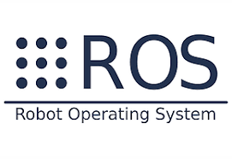


What’s Next?
Enhance GP Mapping & Scalability
Increase Realism & Robustness
ROS & Gazebo integration
Real-World Deployment & Optimization
F1TENTH Autonomous Car Integration

